Slide 1


Image Processing & Machine Vision
Continuous Assessment
Vivekanand Education Society's Institute of Technology
An Autonomous Institute Affiliated to University of Mumbai
Number Plate Recognition using Simulink
ELECTRONICS AND TELECOMMUNICATION ENGINEERING
Group No. : B14
Students Name- Roll Numbers(Class name)
Anoushka Menon-32(D14B)
Utsav Mutadak-36(D14B)
Khushi Purohit-51(D14B)
Anuraag Rao-52(D14B)

Slide 2
Problem Statement
To design and implement a Simulink based simulation for number plate recognition.

Slide 3
Proposed Solution
We plan to implement a Simulink-based simulation for Number Plate Recognition (NPR) in Simulink, design and integrate modules for image acquisition, preprocessing and number plate localization. We can also develop algorithms using techniques like edge detection and evaluate system performance using metrics such as accuracy and precision.

Slide 4
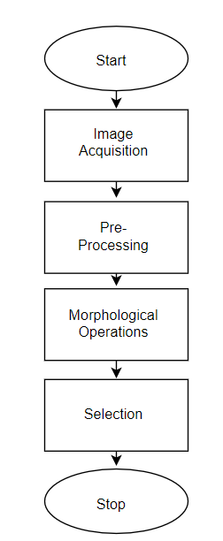
Flow Chart of System

Slide 5
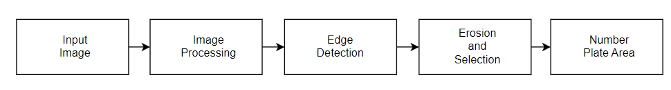
Complete Block Diagram of Proposed System
fig 1. Blocks to be used in Number Plate Recognition System

Slide 6
Methodology/Algorithm
Image Acquisition and Preprocessing: The system begins by acquiring images frames containing vehicles. Preprocessing techniques are applied to enhance image quality, remove noise, and improve the clarity of license plate regions.
Edge Detection: Using masks like Sobel kernel, we can isolate horizontal and vertical edges to recognize the number plate area from an image of a vehicle
Morphological Operation and Selection: The edge detected image is eroded to thin the borders of the image. It is then cropped to extract the rectangular portion of the number plate.
Output Display: Finally, the recognized license plate area is either displayed to the user or integrated into a larger system for further processing, number plate character extraction.

Slide 7
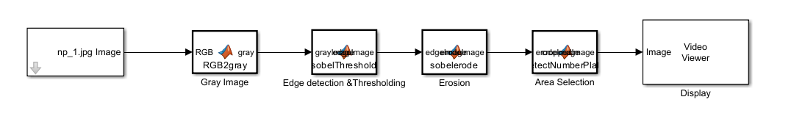
Observations / Results
Block Diagram in Simulink

Slide 8
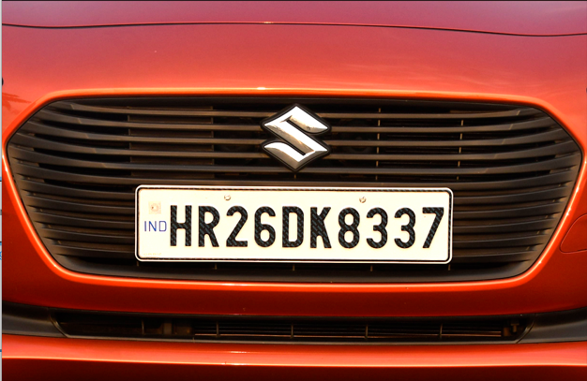
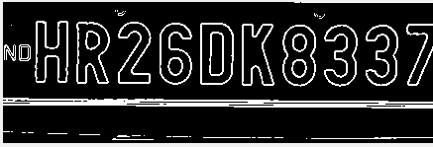
Observations / Results
Input Image
Output Image

Slide 9
Conclusion
The number plate recognition system implemented in Simulink demonstrates the feasibility of using image processing techniques for detecting a number plate from images of vehicles
Through the utilization of image preprocessing and edge detection algorithms, the system effectively extracts number plate area from input images.

Slide 10
References
1)Z. Selmi, M. B. Halima and A. M. Alimi, "Deep learning system for automatic license plate detection and recognition", 2017 14th IAPR international conference on document analysis and recognition (ICDAR), vol. 1, pp. 1132-1138, 2017
2) J. Albert Mayan, K. Akash Deep, M. Kumar, L. Alvin, S.P. Reddy,”Number Plate Recognition using Template Comparison for various fonts in MATLAB” ,2016 IEEE International Conference on Computational Intelligence and Computing Research
3) S. Belongie, J. Malik and J. Puzicha, "Shape matching and object recognition using shape contexts", IEEE transactions on pattern analysis and machine intelligence, vol. 24, no. 4, pp. 509-522, 2002

Slide 11
Thank You!

